Slide 1
.Net Standard with Xamarin
By Ken Tucker

Slide 2
What we are going to cover
What are Portable Class Libraries
What is .Net Standard
Using Entity Framework Core with Xamarin for Android
Using Entity Framework Core with Xamarin Forms

Slide 3
What are portable class libraries
First cross platform class library
Nice because you could use with windows, Xamarin, windows phone, xbox
Allowed you to use functions that are in all platforms

Slide 4
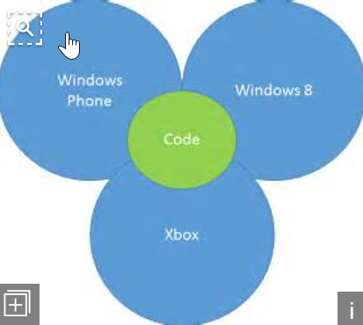
PCL diagram
You could only use the functions that were in all the platforms the PCL was targeting.

Slide 5
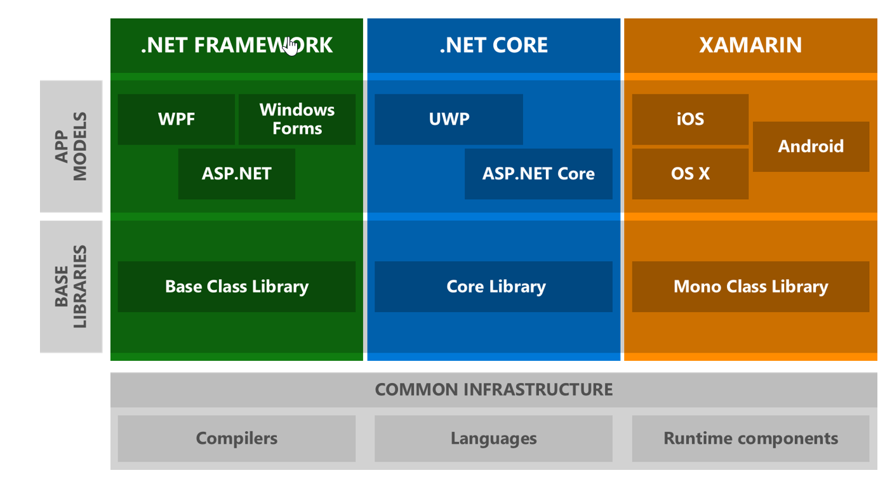
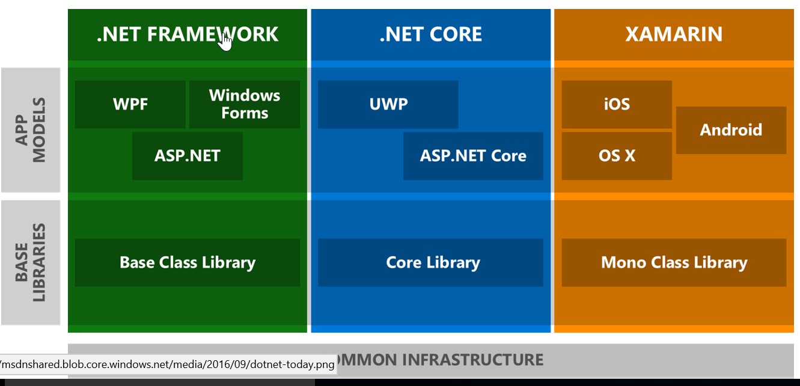
Why do we need Standard Libraries

Slide 6
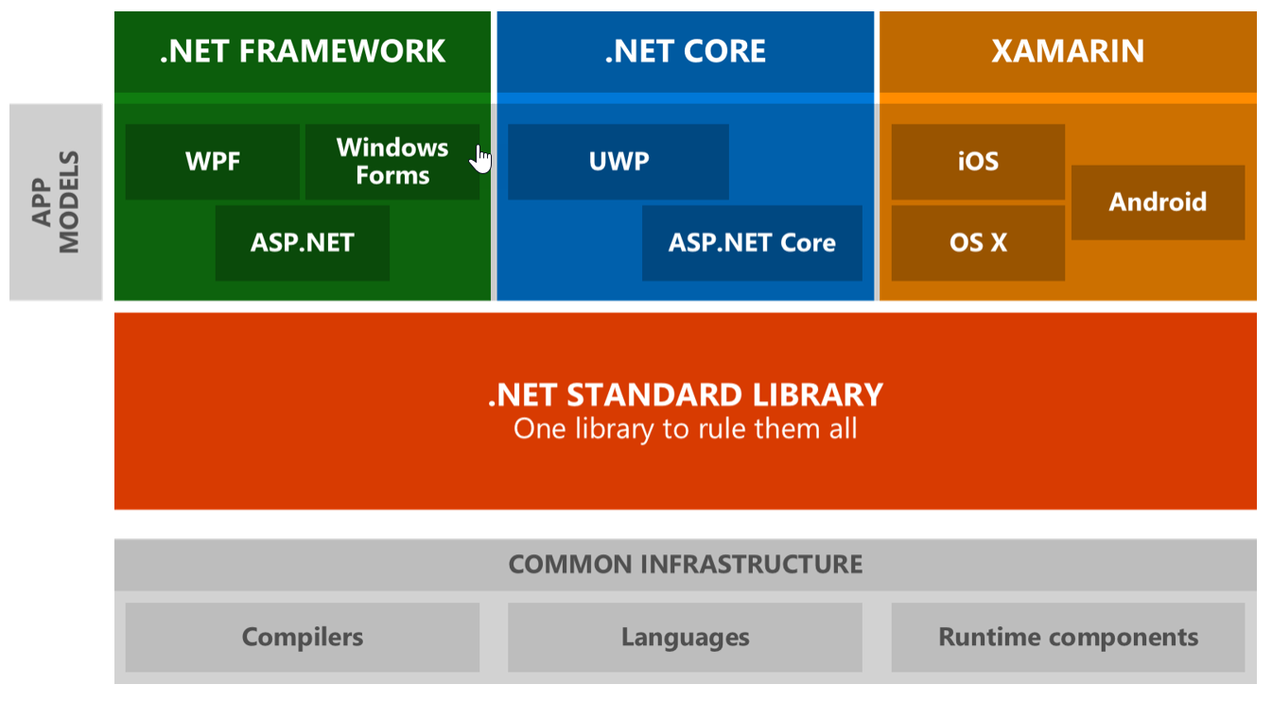
What are standard libraries

Slide 7
Continued
Standard libraries have same functions available in all platforms
.Net standard 2.0 was just released
You need Visual Studio 2017 (15.3) to use the code
.Net standard 2.0 will be supported in Fall Creators update in UWP

Slide 8
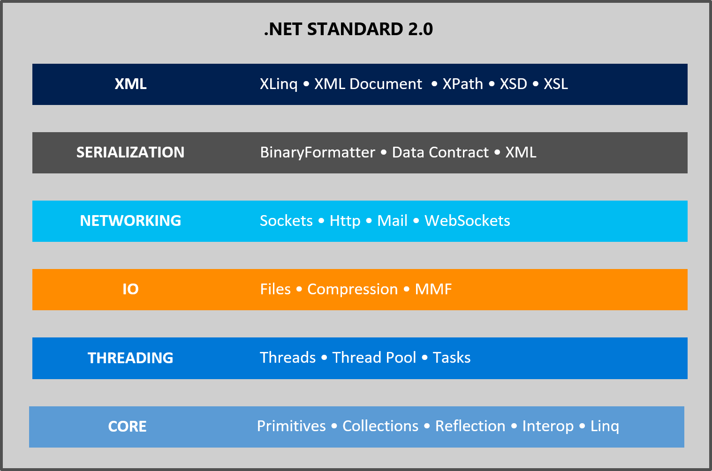
What is included

Slide 9
Also included
System.Data
Things like DataTable

Slide 10
Xamarin Android
Create a new Xamarin Android project
Add EntityFrameworkCore.Sqlite NuGet package
Add Class for table and data context
Connect and make sure table is created and add an item to
Show in a listview

Slide 11
Add to Xamarin forms
For .net stardard 1.x you had to
Create a new Xamarin forms project that uses a PCL
Remove NuGet packages
Change to standard library which targets 1.3
Update project.json
Add Xamarin forms NuGet package back

Slide 12
Add to Xamarin forms
For .net stardard 2.x you have to
Create a new Xamarin forms project that uses a PCL
Add a new standard library project
Copy app.xaml and MainForm to new project
Add and update Xamarin forms 2.4 pre-release to all projects
Edit project file
Remove pcl and update namespace to standard library

Slide 13
Add Entityframework core
Run project and make sure it works
Add Microsoft.EntityFrameworkCore.Sqlite NuGet package
Add classes for table and data context
Add FreshMVVM
Make sure Sqlite database is created at startup

Slide 14
Interact with the database
Add items to database
Update items in database

Slide 15
Resources
Sample code is on GitHub
https://github.com/vb2ae/AndroidEFDemo
https://github.com/vb2ae/XamarinFormsEntityFramework
https://www.microsoft.com/net/download
https://github.com/vb2ae/CodeImpactNetStandard
https://docs.microsoft.com/en-us/dotnet/articles/standard/library

Slide 16
Ken tucker
Blog
http://www.onteorasoftware.com/
Twitter @vb2ae

